Slide 1
File Handling and serialization

Slide 2
File Handling in Java
In Java, file handling is performed using the java.io package, which allows us to create, read, write, update, and delete files.
The File class provides an abstraction for file and directory pathnames.
The File class from the java.io package, allows us to work with files.
To use the File class, create an object of the class, and specify the filename or directory name
import java.io.File; // Import the File class
File myObj = new File("filename.txt"); // Specify the filename

Slide 3
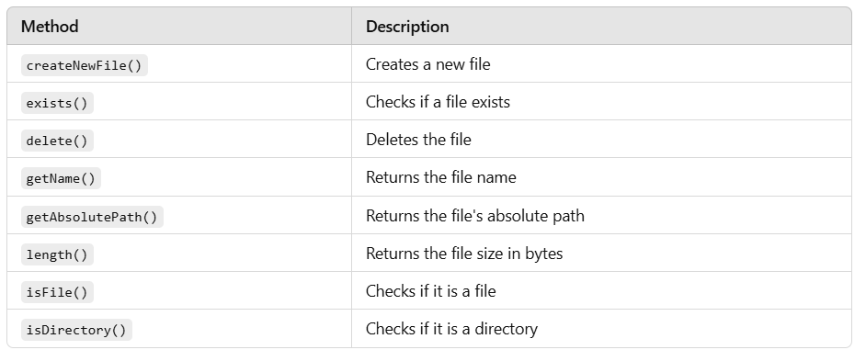
Important Methods of File Class –

Slide 4
Creating and Checking a File –
import java.io.File;
import java.io.IOException;
public class FileExample {
public static void main(String[] args) {
File file = new File("example.txt"); // Creating a File object
try {
if (file.createNewFile()) { // Creating the actual file
System.out.println("File created: " + file.getName());
} else {
System.out.println("File already exists.");
}
} catch (IOException e) {
System.out.println("An error occurred.");
e.printStackTrace();
}
// Checking file properties
System.out.println("File exists: " + file.exists());
System.out.println("Is File: " + file.isFile());
System.out.println("File size: " + file.length() + " bytes");
}
}
Notes:
File file = new File("example.txt"); → Creates a reference to the file.
file.createNewFile(); → Creates the file if it does not already exist.
file.exists(); → Checks if the file exists.
file.isFile(); → Checks if it is a file (not a directory).
file.length(); → Returns the size of the file in bytes.

Slide 5
Creating a Directory –
import java.io.File;
public class CreateDirectory {
public static void main(String[] args) {
File dir = new File("NewDirectory");
if (dir.mkdir()) {
System.out.println("Directory created: " + dir.getName());
} else {
System.out.println("Directory already exists.");
}
}
}

Slide 6
Creating a Directory – mkdirs - Creates the directory along with all non-existent parent directories.
import java.io.File; import java.io.IOException; public class Main { public static void main(String[] args) { File file = new File("C:/data/G-13/mydir1"); try { boolean check = file.mkdirs(); if (check){ System.out.println("File created"); System.out.println(file.getName()); } else { System.out.println("File already exists"); } } catch (Exception exception){ System.out.println(exception); } } }
Notes:
If we will use mkdir() in the above case, then it will fails if the parent directories don't exist. i.e data/G-13 bith should already be exists only then in this case we can create mydir1 using mkdir() however this is not the case with mkdirs();

Slide 7
Listing Files in a Directory –
import java.io.File;
public class ListFilesExample {
public static void main(String[] args) {
File folder = new File("C:\\Users");
if (folder.isDirectory()) {
String[] files = folder.list(); // Get file names
for (String file : files) {
System.out.println(file);
}
} else {
System.out.println("Not a directory.");
}
}
}

Slide 8
Deleting a File –
import java.io.File;
public class DeleteFileExample {
public static void main(String[] args) {
File file = new File("example.txt");
if (file.delete()) {
System.out.println("Deleted: " + file.getName());
} else {
System.out.println("Failed to delete.");
}
}
}

Slide 9
FAQs
Q1: Can File class read/write content?
❌ No, the File class only deals with file metadata and directory handling. Use FileReader/FileWriter or BufferedReader/BufferedWriter for reading/writing.
Q2: What happens if I call mkdir() on an existing directory?
Nothing. It returns false but doesn't throw an error.
Q3: How do I create nested directories?
Use mkdirs() instead of mkdir().
File dirs = new File("parentDir/childDir");
dirs.mkdirs(); // Creates both if not exist
Q4: Can I check if a file is hidden?
Yes, use file.isHidden().

Slide 10
Practice questions –
1 - Write a Java program that takes a directory path as input and prints the names of all files (not directories) present in that directory.
Requirements:
Use java.io.File
Handle the case where the directory path is invalid or does not exist.
2 - Create a Java program that counts and displays the number of files and subdirectories present in a given directory.
Requirements:
Use File[] listFiles() method
Differentiate between files and directories using isFile() and isDirectory()

Slide 11
3 - Write a program to create a new file with a given name. If the file is successfully created, print:
File name
Absolute path
Is the file writable?
Is the file readable?
File length in bytes (which should be 0 at creation)
Requirements:
Use methods like createNewFile(), getAbsolutePath(), canRead(), canWrite(), and length()

Slide 12
1 –
import java.io.File;
import java.util.Scanner;
public class ListFilesInDirectory {
public static void main(String[] args) {
Scanner scanner = new Scanner(System.in);
System.out.print("Enter directory path: ");
String path = scanner.nextLine();
File directory = new File(path);
if (directory.exists() && directory.isDirectory()) {
File[] files = directory.listFiles();
System.out.println("Files in directory:");
for (File file : files) {
if (file.isFile()) {
System.out.println("File: " + file.getName());
}
}
} else {
System.out.println("Invalid directory path.");
}
scanner.close();
}
}

Slide 13
2 –
import java.io.File;
public class CountFilesAndDirs {
public static void main(String[] args) {
String path = "C:\\Users\\Rohit\\Documents"; // You can change this path
File directory = new File(path);
if (directory.exists() && directory.isDirectory()) {
int fileCount = 0;
int dirCount = 0;
File[] list = directory.listFiles();
for (File file : list) {
if (file.isFile()) {
fileCount++;
} else if (file.isDirectory()) {
dirCount++;
}
}
System.out.println("Total Files: " + fileCount);
System.out.println("Total Directories: " + dirCount);
} else {
System.out.println("Invalid directory path.");
}
}
}

Slide 14
3 –
import java.io.File;
import java.io.IOException;
import java.util.Scanner;
public class CreateFileMetadata {
public static void main(String[] args) {
Scanner scanner = new Scanner(System.in);
System.out.print("Enter file name to create (e.g., output.txt): ");
String fileName = scanner.nextLine();
File file = new File(fileName);
try {
if (file.createNewFile()) {
System.out.println("File created: " + file.getName());
System.out.println("Absolute Path: " + file.getAbsolutePath());
System.out.println("Readable: " + file.canRead());
System.out.println("Writable: " + file.canWrite());
System.out.println("Size: " + file.length() + " bytes");
} else {
System.out.println("File already exists.");
}
} catch (IOException e) {
System.out.println("An error occurred.");
e.printStackTrace();
}
scanner.close();
}
}

Slide 15
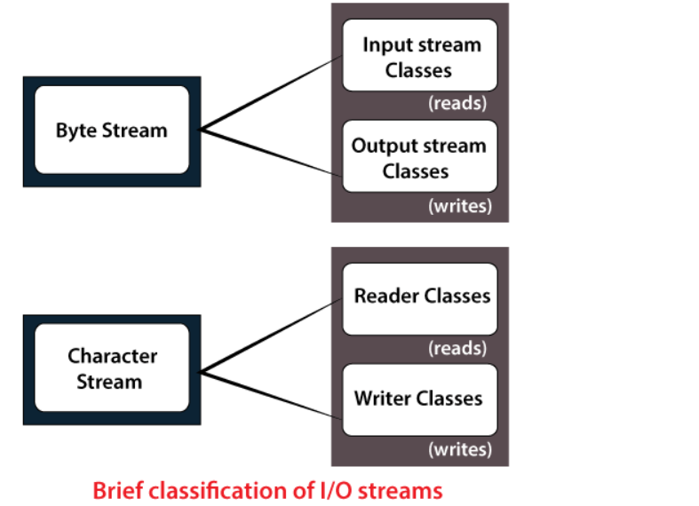
Stream
A Stream in Java represents a continuous flow of data, which can be input (reading data) or output (writing data). Streams are categorized into Byte Streams and Character Streams.
Notes:
InputStream and OutputStream are abstract base classes from the java.io package, and they have many subclasses designed for different data sources and sinks.

Slide 16
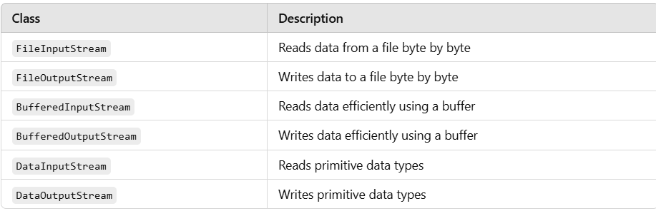
Byte Streams (Binary Data)
Byte streams are used for handling binary data such as images, audio, and video files. These streams work with 8-bit bytes.
Key Classes for Byte Streams –
Notes:
All are the child of InputStream and OutputStream classes.
BufferedInputStream and BufferedOutputStream use a buffer to optimize performance.
FileInputStream and FileOutputStream: These read/write one byte at a time from/to the file. This means each read/write operation hits the disk, which is relatively slow.
BufferedInputStream and BufferedOutputStream: These wrap around FileInputStream / FileOutputStream and use an internal byte array (buffer) to reduce the number of disk access operations.
Without Buffering (FileInputStream/FileOutputStream):
Suppose you want to read a 1 MB file.
If you use FileInputStream, and read 1 byte at a time, you make 1 million disk I/O operations.
Each I/O operation is expensive (slow).
With Buffering (BufferedInputStream/BufferedOutputStream):
A BufferedInputStream might use a default buffer size of 8 KB.
So, it reads 8192 bytes in one go and stores them in memory.

Slide 17
Writing and Reading using Byte Streams –
import java.io.FileInputStream;
import java.io.FileOutputStream;
import java.io.IOException;
public class ByteStreamExample {
public static void main(String[] args) {
String data = "Hello, Byte Streams!";
// Writing to a file
try (FileOutputStream fos = new FileOutputStream("bytefile.txt")) {
fos.write(data.getBytes()); // Converting string to byte array
System.out.println("Data written successfully.");
} catch (IOException e) {
e.printStackTrace();
}
// Reading from a file
try (FileInputStream fis = new FileInputStream("bytefile.txt")) {
int i;
while ((i = fis.read()) != -1) { // Reading byte by byte
System.out.print((char) i); // Converting byte to character
}
} catch (IOException e) {
e.printStackTrace();
}
}
}
Notes:
try (FileOutputStream fos = new FileOutputStream("bytefile.txt")) -> The try-with-resources statement automatically closes the FileOutputStream.
fis.read() reads one byte at a time, and returns -1 when the end of the file is reached.

Slide 18
Writing
FileOutputStream fos = new FileOutputStream("bytefile.txt"); → Opens a file for writing.
fos.write(data.getBytes()); → Converts the string into bytes and writes to the file.
Reading
FileInputStream fis = new FileInputStream("bytefile.txt"); → Opens a file for reading.
fis.read(); → Reads one byte at a time.
System.out.print((char) i); → Converts byte back to character and prints.

Slide 19
Append Data:
import java.io.FileOutputStream;
public class AppendToFileExample {
public static void main(String[] args) {
try (FileOutputStream fileOutputStream = new FileOutputStream("C:/data/demo.txt", true)) {
String data = " Hello again!";
fileOutputStream.write(data.getBytes());
System.out.println("Append done");
} catch (Exception exception) {
System.out.println(exception);
}
}
}

Slide 20
BufferedInputStream wraps FileInputStream to read data more efficiently by using an internal buffer, reducing the number of disk access operations.
BufferedOutputStream wraps FileOutputStream to improve write performance by collecting bytes in a buffer before writing them all at once to the file.

Slide 21
import java.io.BufferedInputStream;
import java.io.BufferedOutputStream;
import java.io.FileInputStream;
import java.io.FileOutputStream;
import java.io.IOException;
public class BufferedByteStreamExample {
public static void main(String[] args) {
String data = "Hello, Buffered Byte Streams!";
// Writing using BufferedOutputStream
try (BufferedOutputStream bos = new BufferedOutputStream(new FileOutputStream("bufferedfile.txt"))) {
bos.write(data.getBytes()); // Writes data to buffer
bos.flush(); // Forces any remaining data to be written to file
System.out.println("Data written successfully using BufferedOutputStream.");
} catch (IOException e) {
e.printStackTrace();
}
// Reading using BufferedInputStream
try (BufferedInputStream bis = new BufferedInputStream(new FileInputStream("bufferedfile.txt"))) {
int i;
while ((i = bis.read()) != -1) { // Reads from buffer
System.out.print((char) i); // Print character
}
} catch (IOException e) {
e.printStackTrace();
}
}
}

Slide 22
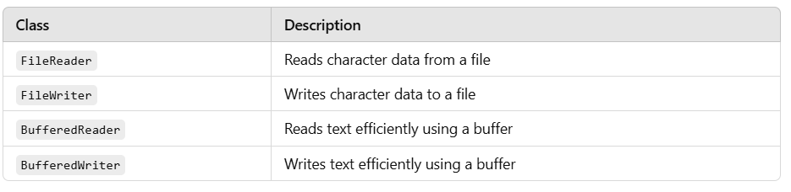
Character Streams (Text Data)
Character streams handle text files (like .txt or .csv) and work with 16-bit Unicode characters.
Key Classes for Character Streams -

Slide 23
Writing and Reading using Character Streams –
import java.io.FileReader;
import java.io.FileWriter;
import java.io.IOException;
public class CharacterStreamExample {
public static void main(String[] args) {
String data = "Hello, Character Streams!";
// Writing to a file
try (FileWriter writer = new FileWriter("charfile.txt")) {
writer.write(data); // Writing string directly
System.out.println("Data written successfully.");
} catch (IOException e) {
e.printStackTrace();
}
// Reading from a file
try (FileReader reader = new FileReader("charfile.txt")) {
int i;
while ((i = reader.read()) != -1) { // Reading character by character
System.out.print((char) i);
}
} catch (IOException e) {
e.printStackTrace();
}
}
}

Slide 24
Explanation
Writing
FileWriter writer = new FileWriter("charfile.txt"); → Opens a file for writing.
writer.write(data); → Directly writes characters to the file.
Reading
FileReader reader = new FileReader("charfile.txt"); → Opens a file for reading.
reader.read(); → Reads one character at a time.

Slide 25
Buffered Streams
Buffered streams improve efficiency and speed by reducing the number of direct I/O operations. They store data in an internal buffer before sending or receiving it in chunks.
BufferedReader and BufferedWriter –

Slide 26
import java.io.*;
public class BufferedStreamExample {
public static void main(String[] args) throws IOException {
// Writing using BufferedWriter
BufferedWriter writer = new BufferedWriter(new FileWriter("bufferedfile.txt"));
writer.write("Hello, Buffered Streams!");
writer.newLine();
writer.write("This is the second line.");
writer.close();
// Reading using BufferedReader
BufferedReader reader = new BufferedReader(new FileReader("bufferedfile.txt"));
String line;
while ((line = reader.readLine()) != null) {
System.out.println(line);
}
reader.close();
}
}
Notes:
BufferedWriter writes data efficiently and allows adding new lines.BufferedReader reads data line by line.

Slide 27
Object Serialization and Deserialization
What is Serialization?
Serialization is the process of converting a Java object into a byte stream, so it can be:
Saved to a file
Sent over a network
Stored in memory or database
Java provides ObjectOutputStream for serialization.
What is Deserialization?
Deserialization is the reverse process — converting the byte stream back into a Java object.
Java provides ObjectInputStream for deserialization.
Key Requirements:
The class must implement Serializable interface.

Slide 28
Example: Serialize and Deserialize a Student Object –
import java.io.Serializable;
public class Student implements Serializable {
int id;
String name;
public Student(int id, String name) {
this.id = id;
this.name = name;
}
}
Notes:
implements Serializable -> Tells Java this object can be converted into a stream (serialized).

Slide 29
Serialization (Writing the Object to a File) –
import java.io.FileOutputStream;
import java.io.ObjectOutputStream;
public class SerializeDemo {
public static void main(String[] args) {
Student student = new Student(101, "Rohit");
try (FileOutputStream fileOut = new FileOutputStream("student.txt");
ObjectOutputStream out = new ObjectOutputStream(fileOut)) {
out.writeObject(student);
System.out.println("Object has been serialized");
} catch (Exception e) {
e.printStackTrace();
}
}
}
Notes:
Student student = new Student(...) - Creates an object to serialize.
FileOutputStream("student.txt") - Opens a file named student.ser for writing.
ObjectOutputStream(...) - Converts Java object into binary stream.
out.writeObject(student) - Serializes and writes the object into the file.
try-with-resources - Automatically closes streams after use.

Slide 30
Deserialization (Reading the Object Back) –
import java.io.FileInputStream;
import java.io.ObjectInputStream;
public class DeserializeDemo {
public static void main(String[] args) {
try (FileInputStream fileIn = new FileInputStream("student.txt");
ObjectInputStream in = new ObjectInputStream(fileIn)) {
Student student = (Student) in.readObject();
System.out.println("Object has been deserialized");
System.out.println("ID: " + student.id);
System.out.println("Name: " + student.name);
} catch (Exception e) {
e.printStackTrace();
}
}
}
Notes:
FileInputStream("student.ser") - Opens the file containing the serialized object.
ObjectInputStream(...) - Reads object from binary stream.
readObject() - Reads and converts the byte stream back into a Student object.

Slide 31
transient -
transient keyword is used to exclude a field from serialization.
When an object is serialized:
All non-transient fields are saved.
All transient fields are skipped — they are not written to the file.
This is useful when:
A field contains sensitive data (like passwords).
A field is not serializable.
A field is not needed after deserialization.

Slide 32
Example –
import java.io.Serializable;
public class User implements Serializable {
private static final long serialVersionUID = 1L;
String username;
transient String password;
public User(String username, String password) {
this.username = username;
this.password = password;
}
}
Notes:
Here, the password field is marked as transient, so it won’t be saved during serialization.

Slide 33
Serialize the Object –
import java.io.FileOutputStream;
import java.io.ObjectOutputStream;
public class SerializeUser {
public static void main(String[] args) {
User user = new User("rohit123", "mySecretPassword");
try (FileOutputStream fileOut = new FileOutputStream("user.ser");
ObjectOutputStream out = new ObjectOutputStream(fileOut)) {
out.writeObject(user);
System.out.println("User object has been serialized.");
} catch (Exception e) {
e.printStackTrace();
}
}
}

Slide 34
Deserialize and Observe –
import java.io.FileInputStream;
import java.io.ObjectInputStream;
public class DeserializeUser {
public static void main(String[] args) {
try (FileInputStream fileIn = new FileInputStream("user.ser");
ObjectInputStream in = new ObjectInputStream(fileIn)) {
User user = (User) in.readObject();
System.out.println("User object has been deserialized.");
System.out.println("Username: " + user.username);
System.out.println("Password: " + user.password); // will print: null
} catch (Exception e) {
e.printStackTrace();
}
}
}

Slide 35
Practice questions –
Q1: Byte-by-Byte File Copy
Topic: FileInputStream and FileOutputStream
Write a Java program to:
Take a source file path and destination file path from the user.
Copy the content byte-by-byte using FileInputStream and FileOutputStream.
Display the time taken to copy the file.
Now modify the same program using BufferedInputStream and BufferedOutputStream to show performance improvement.
Q2: Count Vowels Using Character Stream
Topic: FileReader and BufferedReader Write a Java program to:
Read a text file using BufferedReader.
Count and print how many vowels (a, e, i, o, u) are present in the file.
Also display how many lines the file contains.
Use readLine() for line-by-line or read() for char-by-char.

Slide 36
1 –
import java.io.*;
public class FileCopyBasic {
public static void main(String[] args) throws IOException {
long startTime = System.currentTimeMillis();
FileInputStream fis = new FileInputStream("source.txt");
FileOutputStream fos = new FileOutputStream("destination_basic.txt");
int b;
while ((b = fis.read()) != -1) {
fos.write(b);
}
fis.close();
fos.close();
long endTime = System.currentTimeMillis();
System.out.println("File copied using basic streams in " + (endTime - startTime) + " ms");
}
}

Slide 37
1 – Using java.time –
import java.io.*;
import java.time.Duration;
import java.time.Instant;
public class FileCopyWithTime {
public static void main(String[] args) {
File inputFile = new File("source.txt");
File outputFile = new File("destination.txt");
Instant start = Instant.now(); // Start time
try (
FileInputStream fis = new FileInputStream(inputFile);
FileOutputStream fos = new FileOutputStream(outputFile)
) {
int data;
while ((data = fis.read()) != -1) {
fos.write(data);
}
System.out.println("File copied successfully.");
} catch (IOException e) {
e.printStackTrace();
}
Instant end = Instant.now(); // End time
Duration timeTaken = Duration.between(start, end);
System.out.println("Time taken: " + timeTaken.toMillis() + " ms");
}
}

Slide 38
2 –
import java.io.*;
public class VowelLineCounter {
public static void main(String[] args) throws IOException {
BufferedReader reader = new BufferedReader(new FileReader("vowelsample.txt"));
int lineCount = 0, vowelCount = 0;
String line;
while ((line = reader.readLine()) != null) {
lineCount++;
for (char c : line.toLowerCase().toCharArray()) {
if ("aeiou".indexOf(c) != -1) {
vowelCount++;
}
}
}
reader.close();
System.out.println("Total Lines: " + lineCount);
System.out.println("Total Vowels: " + vowelCount);
}
}

